Slide 1


Year 9
Information Evening
Mr Hillis – Key Stage 3 Leader

Slide 2
Purpose of the Evening
An Introduction to Key Staff
Teaching and Learning in Year 9
Key Information and Dates for the Year Ahead
Pastoral Care in the College
Notes:
HSLvital for parents to support young person and College on 5 yr 7yr journey.
Meet FT key pastoral link

Slide 3
School Vision
‘A forward-thinking school where all pupils are encouraged to achieve their aspirations and fulfil their potential in an inclusive, safe and caring community’
School Values
R – Respect
E – Effort
A – Achievement
C – Community
H – Happiness

Slide 4
Three Expectations
Be Ready | Be Safe | Be Respectful
Arrive on time | Walk in the corridors | Greet everyone politely
Line up outside classes | Follow the one-way system | Speak respectfully
Bring correct equipment | Keep hands and feet to myself | Use good manners
Wear correct uniform | Do not throw objects | Be kind to everyone
Have a positive attitude | Use technology and equipment safely | Hold doors open
Focus in class | Follow staff instructions | Sit in allocated class seat
Show determination | Board and use the bus safely | Do not drop litter

Slide 5
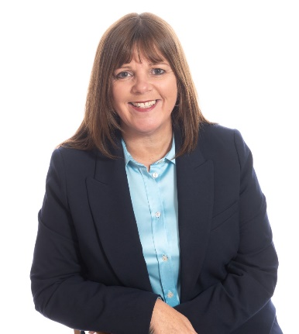

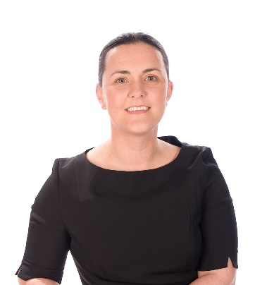
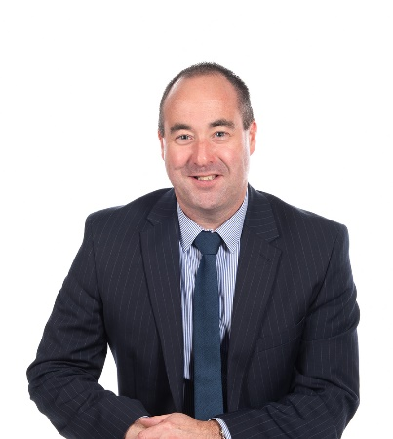
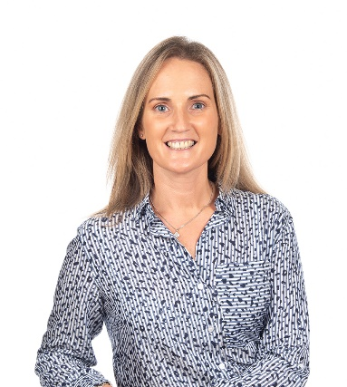
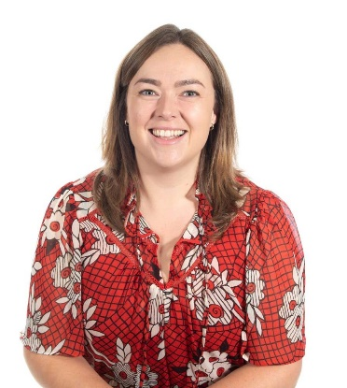
Senior Leadership Team
Mrs Stevenson
Principal
Mrs Beckett
Strategic Lead Pastoral Care
Ms Cunningham
Vice Principal Teaching and Learning
Mr Dane
Vice Principal
Pastoral Care and Safeguarding
Mrs Reid
Strategic Lead
School Organisation and Timetabling
Mrs McErlean
Strategic Lead
Curriculum & Pathways

Slide 6
Safeguarding Team
Designated Teacher for Child Protection
Mr M Dane
Deputy Designated Teacher for Child Protection
Mrs K Beckett
Miss E Collins
Principal – Mrs N Stevenson

Slide 7

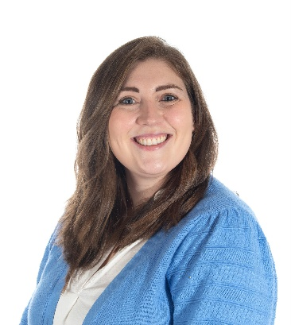
Year 9 Pastoral Team
Mr Hillis
Key Stage 3 Leader
To Be Appointed
Head of Year - Boys
Mrs Lea
Head of Year - Girls
9GS | 9REA | 9ER | 9GP | 9SG | 9MM | 9LM | 9RC
Mr Sykes | Mrs Cuthbertson Mr Scott (Wed) | Mr Reuss | Mr Proctor | Mrs Gray | Miss McKee | Mrs Rowland | Miss Cathers

Slide 8
Class Structure
8 Form Classes – 7 mixed ability and 1 base class
Named after the Form Teacher
This will remain their form class for their time in LCC

Slide 9
Timetable for 2025/26
Reg | 8.55- 9:10
1 | 9:10 - 9:45
2 | 9:45 - 10:20
BREAK | 10:20 - 10:35
3 | 10:35 - 11:10
4 | 11:10 - 11:45
5 - LUNCH | 11:45 - 12:15
6 - LUNCH | 12:15 - 12:45
7 - LUNCH | 12:45 - 1:15
8 | 1:15 - 1:50
9 | 1:50 - 2:25
10 | 2:25 - 3:00

Slide 10
Curriculum at Laurelhill Community College
Aims:
Child-centred
Broad and Balanced
In line with NI Curriculum
Cater for all abilities, needs, strengths and ambitions of all students
Facilitate the achievement of a minimum of 5 A*-C grades at KS4
Prepare students for life post-16 or post-18

Slide 11
The Year 9 Curriculum
Pathway 1 |  | Pathway 2
English Maths | 7 | English Maths Science | 7
Science | 6 | PE | 4
PE | 4 | Art HE IT Technology | 3
Geography History | 3
Art Drama/Music HE IT Spanish RE Technology | 2 | LLW – Citizenship (to cover language) Environment & Society RE Music/Drama | 2
LLW - Citizenship | 1
Pathway 2 – Base Class (Mrs Cathers)
Yellow = Subjects taught in the base room
Pathway 1 – all other form classes
Streamed for English and Maths

Slide 12
Key Dates, Assessment and Reporting – Year 9
10th – 12th December – Christmas Exams (Tracking 1)
21st January – Pupil Progress Statement
4th February – Parents Consultation
6th March – In Class Assessments (Tracking 2)
26th May – 1st June – Exam Week (Tracking 3)
24th June – Pupil Reports Issued

Slide 13
Home-School Links
SIMS App
Email
Phonecall
Text Messages
Parent Consultations
Social Media

Slide 14
SIMS App and Parent Pay
SIMS App is the central method of communication
Must be logged on a semi-regular basis to stay logged in
Parent Pay is the central method of payment for all school payments
If you have difficulty with either, please contact the office

Slide 15
Illness and Appointments
Please supply reasons for all absences
If a pupil needs to leave for an appointment, send them in with a signed note
Pupils must sign out with the office

Slide 16
Medical and Dietary Needs
Pupil admin forms already submitted with any medical information
Data collection forms will be sent home for confirmation
School Nurse – Hari Irvine
Contact FT with any queries

Slide 17
Pastoral Support and Points of Contact
Form Teacher or Subject Teacher – First Point of Contact
If you wish to speak to a member of staff, please ensure an appointment is made
If you wish to arrange a phone call with a member of staff, please contact the school office

Slide 18
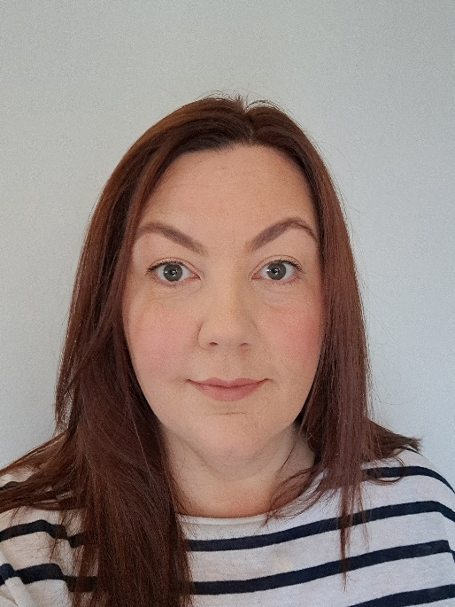
Counselling
Counsellor will be available 3 days per week.
Group, individual and drop in sessions
Speak to form teacher to enquire
Helen

Slide 19
The Emotional Wellbeing Teams in Schools – Parental Resources
The Emotional Wellbeing Teams Resources

Slide 20
Attendance Procedures
Absence note/inform the office
Form tutors will contact you if a student has been absent for more than 3 consecutive days
Holidays during term time are strongly discouraged

Slide 21
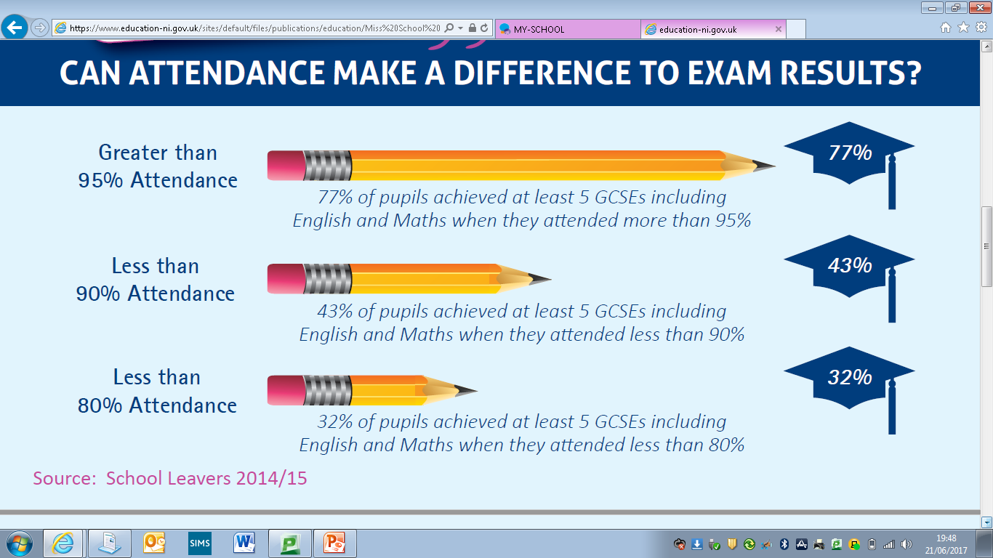

Slide 22
Mobile Phones
Mobile Phone Policy – Please support this.
4.1 If a pupil is using a mobile device in class, he or she will be asked to put the device away. If the pupils cooperates there will be no further action.
4.2 If there is a second occasion where the pupil is using the mobile device in class, the teacher will ask the pupil for the device and it will be sent to the office for the parent to collect at the end of the day.
Pupils should not be using their mobile phone to contact you during the school day.
Social Media.

Slide 23
Extra-Curricular Activities – 2025/26
Basketball
Netball
Football
Hockey
Rugby
Badminton
Running club
Cricket
Programming club
Art (KS3 and Ks4)
Lego club
Science club
Cookery club
Scripture Union
School Production
Music clubs
Brighter minds

Slide 24
Uniform
Uniform list:
Navy Blue Blazer
Dark grey, tailored trousers / charcoal 4 kick pleat skirt
White Shirt
College Tie
Grey jumper
Grey/Black Socks / black opaque tights
Plain black shoes
Summer Blouse / white open neck summer shirt (permitted April - October)
School scarf (optional)
Physical Education Uniform list:
Nike T-Shirt (Royal Blue)
Nike Shorts (Royal blue) / Nike leggings (black) / Nike track suit bottoms (navy) / navy skort
Nike College quarter zip top (optional)
Sports Socks
Track Shoes (non-marking soles)
Football boots
Swimming costume / shorts
Towel required for swimming
Note:
Pupils should wear their uniform to school and change for PE, unless they have a uniform pass
Only school kit should be worn for PE

Slide 25
Behaviour for Learning
Restorative relational approach to promoting positive Behaviour for Learning
Where there are behavioural concerns, pupils will be involved in a process of agreeing targets, strategies and accountability

Slide 26
Homework Planner
Students
Parents
Use the student planner
Write homework in for the day it is due
Helps to meet deadlines
Good way to communicate with your child’s form tutor
- absence notes
- a quick message
Monitor diary and recording of homework

Slide 27
Equipment List
In Pencil Case
Additional
2 x Blue Pens
2 x Black Pens
1 x Red Pen
Pencil
Eraser
Mathematical Instrument Set
Scientific Calculator (GCSE)
Ruler
Sharpener
Set of Colouring Pencils
Highlighter
Glue Stick
PE kit on PE days
Activity dependant – boots/trainers, gum guard, shin pads
Deodorant
A USB pen
Headphones (testing days)

Slide 28
Supporting a Year 9 Student at Home
  Encouraging good attendance and time keeping
  Encouraging organisation and being ready to learn
  Support with homework/revision
  Being aware of key dates – tracking dates, special events etc.
  Encouraging extra-curricular and the social aspect of school life
  Healthy lifestyle
  Taking an interest

Slide 29


