Slide 1


Year 13 and 14
Mrs Duddy- KS5 Leader
Information Evening

Slide 2

Purpose of the Evening
An Introduction to Key Staff
Pastoral Care
Teaching and Learning: KS5
Key Information and Dates for the Year Ahead

Slide 3
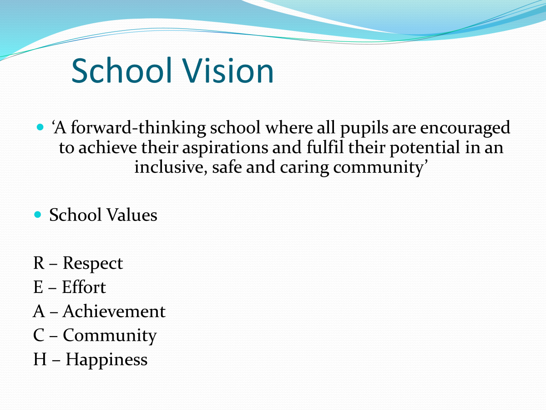


Slide 4
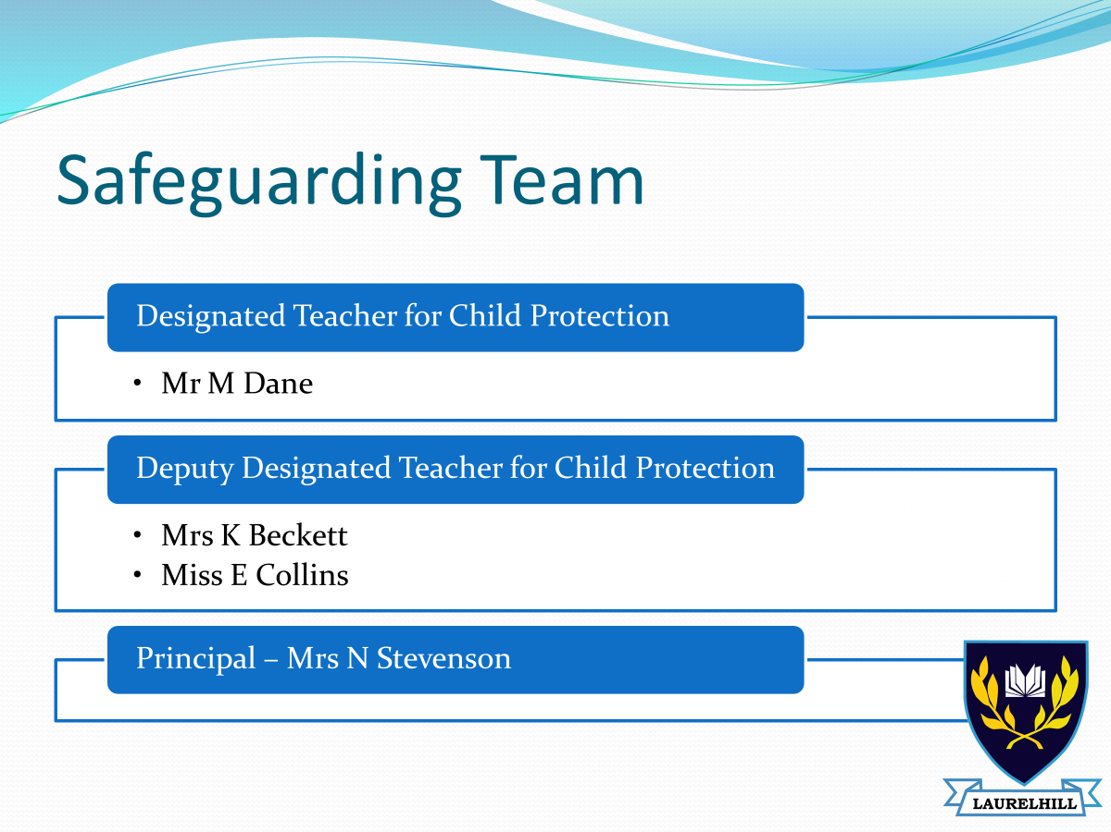

Slide 5
Sixth Form Pastoral Team
Key Stage 5 Leader: Mrs Duddy
13LH1: Miss L Adair
13LH2: Mrs Heaney
14LH1: Mrs Armstrong (MTW)
Mrs L Sneddon (TF)
14LH2: Mrs P Kearney
Miss R McDowell (F)

Slide 6


Points of Contact
Pastoral | Curriculum
Form Tutor Key Stage 5 Leader | Subject Teacher Head of Department
Senior Teacher for Pastoral Care: Mrs Beckett | Senior Teacher for Teaching and Learning: Mrs McErlean (Course enquiry) Vice Principal for Curriculum: Ms Cunningham (Teaching and Learning)
Should you wish to speak to a member of staff, please ensure an appointment is made in advance.

Slide 7
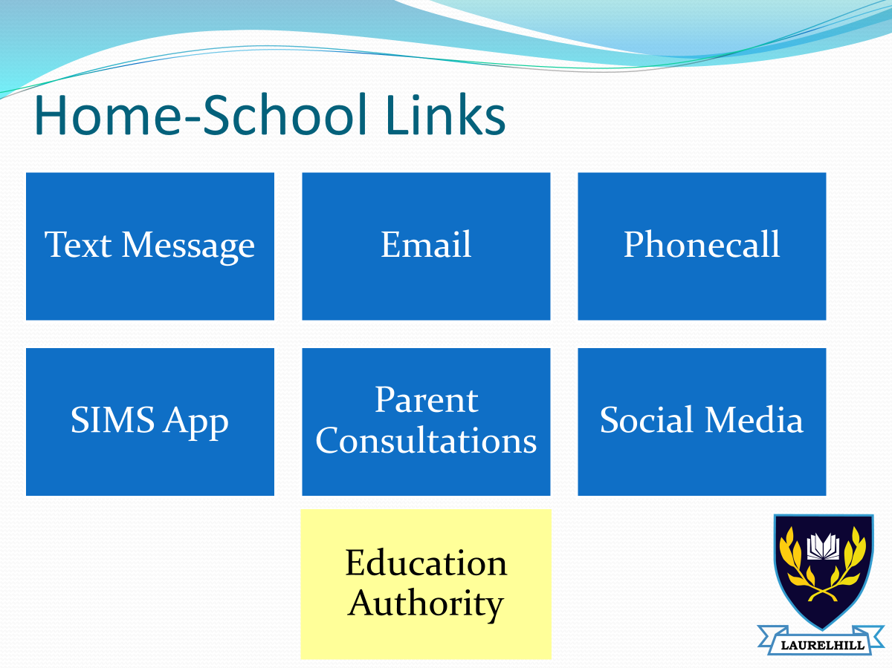

Slide 8
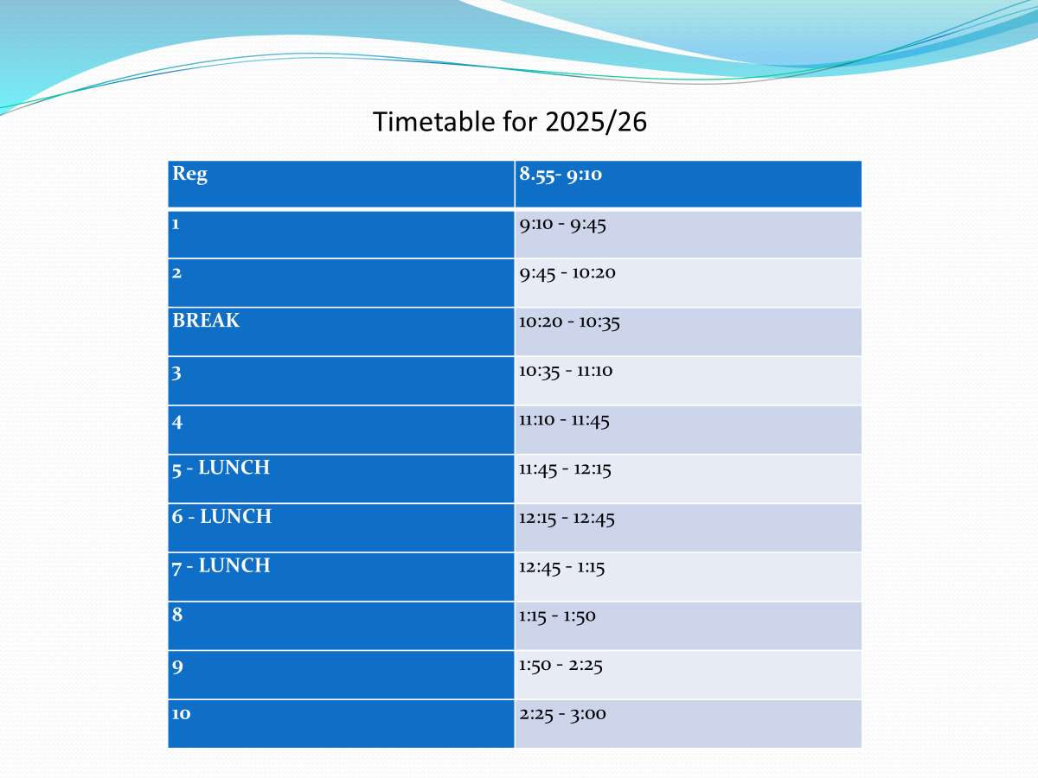

Slide 9
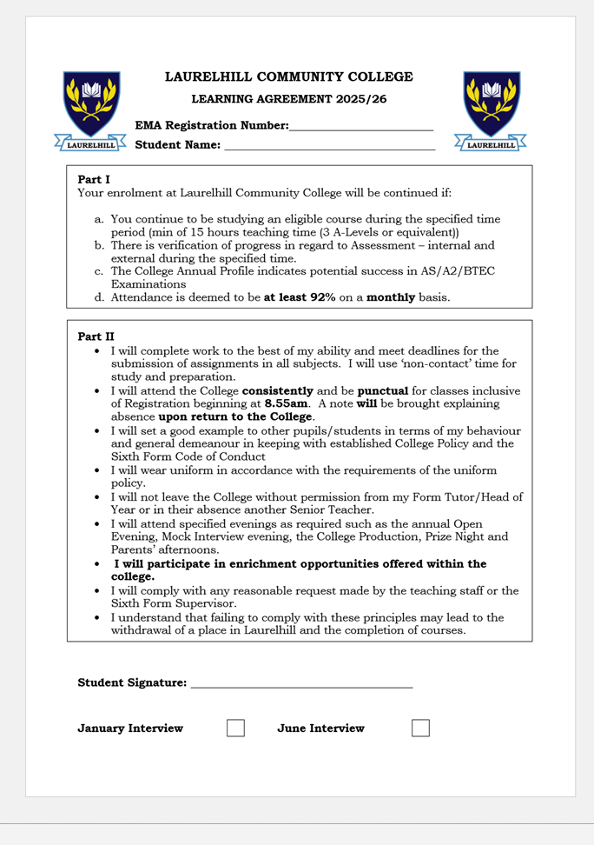
Expectations of a Laurelhill KS5 Pupil:
High Expectations:
Pride in belonging.
High standards of uniform.
High standards of behaviour inside and outside of the college.
A commitment to giving their best in school work.
A commitment to extra-curricular/ community of the school.
Adherence to school policies.

Slide 10

Daily Attendance/ Punctuality
Registration: 8.55am
Lunch: 12.20-12.50 pm (Period 6)
End of college: 3.00pm
Pupil registration taken in all classes.
Compulsory attendance to all timetabled lessons including study time, registration and Assembly.
Pupils are not allowed to leave college unless a note has been provided.

Slide 11
Absences/ Appointments:
Appointments: Note to be provided to form tutor who will record on SIMS.
Pupils MUST sign IN and OUT of college.
Driving Lessons: Permitted during study time-: note must be provided
Driving Tests: Permitted. Note must be provided.
Note must be provided following absences
Holidays during term time are strongly discouraged.

Slide 12
EMA: Educational Maintenance Allowance
The Educational Maintenance Allowance (EMA) is a means-tested payment of £30 a week paid fortnightly to those who are aged 16 to 19 years who continue in education and have a household income below the designated threshold.
The EMA application process can only be completed online
If successful, the school is alerted regarding the pupil's eligibility.
Pupils are required to complete a Learning Agreement form in school and maintain good levels of study, punctuation and attendance as outlined in the Learning Agreement.

Slide 13

Role of Prefect
The role of a prefect is a respected role within Laurelhill Community College.
It is an important leadership opportunity for any pupil to ‘give back’ to the broader school community
As a prefect, pupils are expected to uphold the values of the school at every opportunity and contribute meaningfully to maintaining a safe and caring environment where all pupils feel valued and an integral part of school life.
All pupils in Year 13 may apply to be a Prefect or a more senior position, pupils will undertake an interview for their chosen role in term 3 of Year 13.

Slide 14
Enrichment Opportunities
Aim is to adopt a holistic approach, helping KS5 pupils develop skills of leadership and young adults who are resilient and self-assured. Pupils are encouraged to reflect our core values and ethos.
Brighter Minds
Mentors
Well-Being Ambassadors
Sisters IN
Enrichment Programme
Work Experience- Year 13

Slide 15
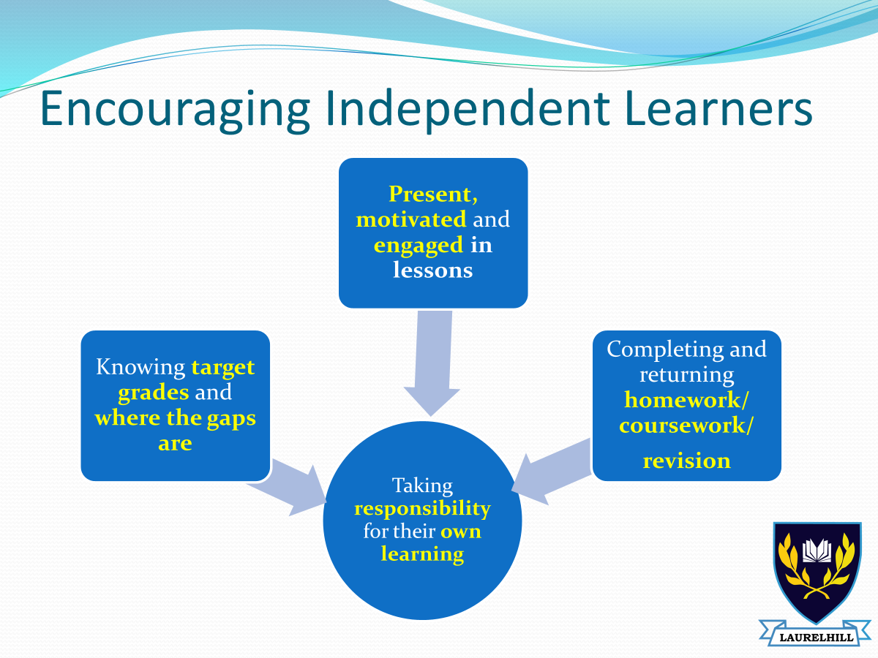
Teaching and Learning
Self-management and independence required
Considering and preparing for next steps

Slide 16
Collaboration: Area Learning Community
This is partnership with other schools and FE providers within the Lisburn Area
Provides a curriculum that is both broad and balanced for pupils
Transportation to and from the selected schools is provided Laurelhill Community College- pupils must be in college by 8.55am
Forthill College | Lisnagarvey High School | South Eastern Regional College
St Ptrick’s Academy | St Colms High School | Malone College

Slide 17
GCE Subjects: 2025/26
BTEC Applied Human Biology Child Care Engineering Music Performance Performing Arts Sport SA Travel and Tourism | A LEVEL Art and Design Business Studies English Literature Environmental Technology Health and Social Care (SA/ DA) History IT Life and Health Science Maths Media Studies Technology and Design Religious Studies
Pathway 2: Triple Award Sport (Football Education Academy)

Slide 18
Careers Guidance and Advice:
At home, please take time to discuss and research with your young person, the post 18 options they have:
University
Further Education College (HND or Foundation Degree)
Apprenticeship/ training
Employment
From this research make a PLAN A, B and C

Slide 19
Careers: Key Dates
Year 13- 1 hour per week | Year 14- 1 hour per week
October – All Year 13 to attend the School Summit event in Eikon Exhibition Centre. Feb 26 -All Y13 to attend application form and CV builder workshop delivered by NI Civil Service. March – All Y13 to participate in mock interview afternoon. June 26- All Y13 to complete a 5 day placement on work experience. | UCAS Deadline: 15/10/25 Deadline for applications for Oxford and Cambridge, and for most courses in medicine, dentistry and veterinary medicine/science. 14/01/26 – UCAS application deadline for all other courses and universities. Year 14 Careers Dept Deadlines: 12/09/25 – Finalised up to 5 UCAS course choices. 26/09/25 – Personal statements completed and submitted to Careers Teacher and Form Tutor. 24/10/25 – UCAS application form sent to Careers Teacher for final checks. 21/11/25 – Any final corrections made and submission of form to UCAS.

Slide 20
Sixth Form Assessment: Key Dates
Tracking 1: Early November
Profile Statement
12/11/25- Year 13 and 14 Parents Consultation
Tracking 2: January Mock
Pupil Profile Report
Tracking 3: February/ March
Profile Statement
AS and A2 Exams :May and June 2026
Coursework and controlled assessments will be completed throughout the year as well as some public exam modules.

Slide 21
Public Exams Assessment Schedule
Examinations and assessment timetables are unique to each individual pupil.
Pupils are encouraged to be familiar with their own exam timetables and submission dates for subjects which involve coursework.

Slide 22
Supporting your young person:
Encourage good attendance and time keeping
Encourage organisation, self-management and independence
Support the completion of homework, coursework and revision
Be aware of key dates- deadlnes, exam modules, results days
Encourage a healthy lifestyle- diet and sleep
Talk about the next steps

