Slide 1


Year 12
Information Evening
Mr Kane – Leader of Key Stage 4

Slide 2

Notes:
Attending the evening

Slide 3
Purpose of the Evening
1. An Introduction to Key Staff
2.Pastoral Care in the College
3. Teaching and Learning in Year 12
4. Key Information and Dates for the Year Ahead

Slide 4

Mission Statement/Core Values
‘A forward-thinking school where all pupils are encouraged to fulfil their potential in an inclusive, safe and caring community’
The school operates under the core values of R-E-A-C-H: These values are used to create a learning culture and students are rewarded for demonstrating them in College.
R – Respect
E – Effort
A – Achievement
C – Community
H – Happiness

Slide 5
The 3 non-negotiables…
The College has three non-negotiable expectations of pupils to assist in creating a safe and positive learning environment.
These are:
Be Ready
Be Safe
Be Respectful

Slide 6
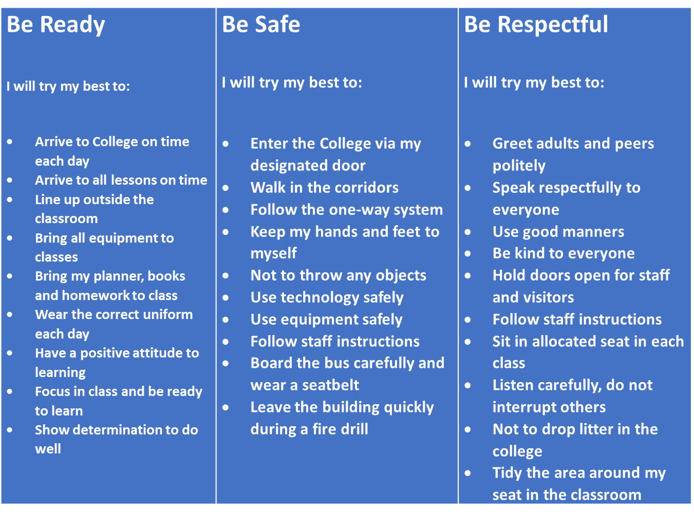

Slide 7
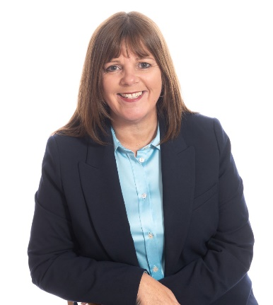
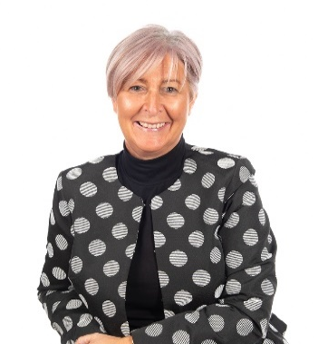
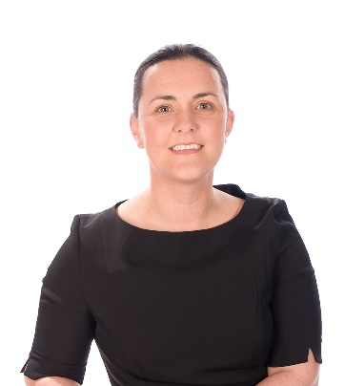
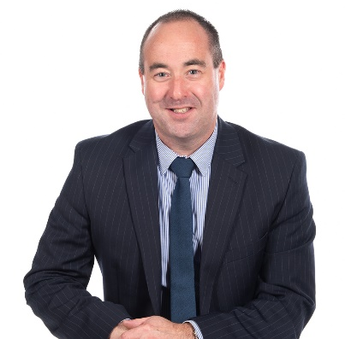
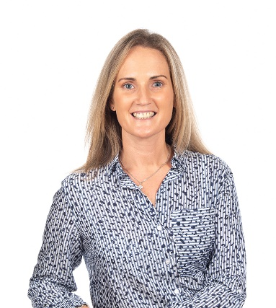
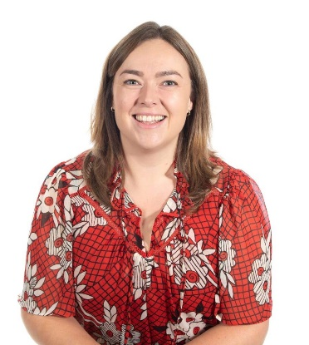

Key Staff
Mrs Stevenson
Principal
Mrs Beckett
Strategic Lead of Pastoral Care
Ms Cunningham
Vice Principal Teaching and Learning
Mr Dane
Deputy Principal
Pastoral Care and Safeguarding
Mrs Reid
Strategic Lead
of School Organisation and Timetabling
Ms McErlean
Strategic Lead
of Curriculum & Pathways

Slide 8
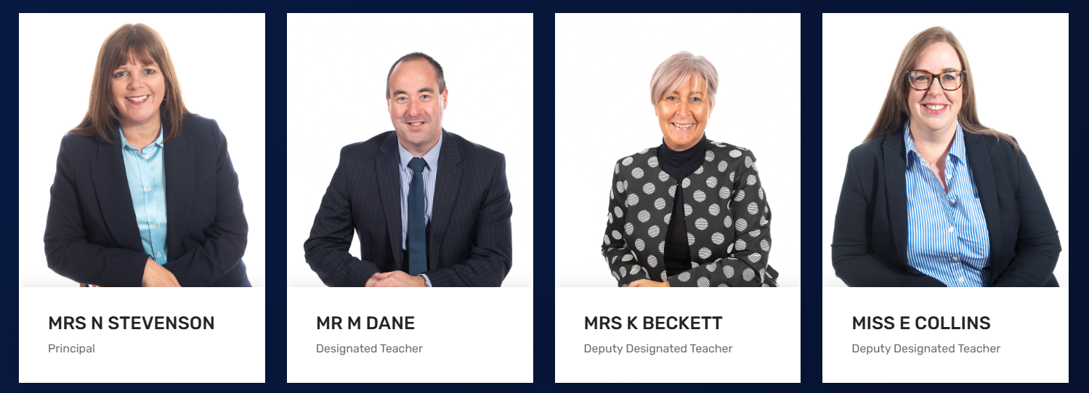
Safeguarding Team

Slide 9
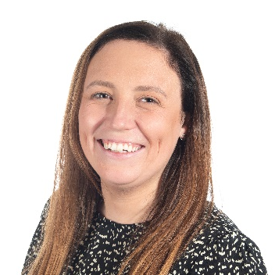
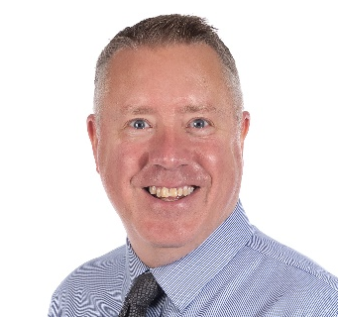
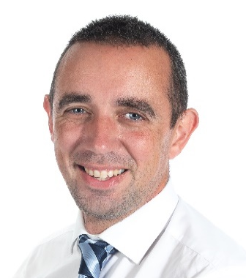
Year 12 Pastoral Team
Ms McClean
Head of Year - Girls
Mr Hines
Head of Year - Boys
Key Stage 4 Leader
12L1 | 12L2 | 12L3 | 12H1 | 12H2 | 12H3 | 12V1 | 12V2
Mrs Dougan | Mr Fitzsimmons | Mrs Kinkead | Miss McGarry | Miss Stubberfield | Miss Collins | Mr Newnham | Mrs Han

Slide 10
Class Structure
No change to the pupils in your child’s form class
This will remain their form class for their time in KS4

Slide 11
Timetable for 2025/26
Reg | 8.55- 9:10
1 | 9:10 - 9:45
2 | 9:45 - 10:20
BREAK | 10:20 - 10:35
3 | 10:35 - 11:10
4 | 11:10 - 11:45
5 | 11:45 - 12:20
6 - LUNCH | 12:20 - 12:50
7 - LUNCH | 12:50 - 1:20
8 – LUNCH | 1:20 - 1:50
9 | 1:50 - 2:25
10 | 2:25 - 3:00

Slide 12
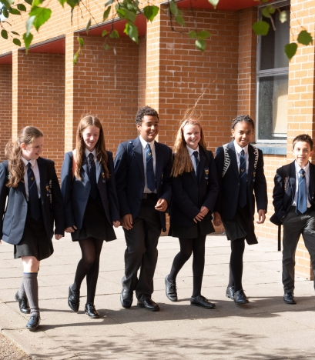
Uniform
Grey Jumper
Black Shoes
Piercings
PE days and match Days

Slide 13


Mobile Phone Policy 2025/26
Mobile phones should not be on during the school day.
Pupils should not contact home via a mobile phone.
Parents/carers should not contact pupils during the day.
Social Media
Notes:
Pupils will be given 1 warning
2nd time teacher can ask for mobile phone and for it to be collected in school office by parent/carer

Slide 14

Appointments
If a pupil needs to leave for an appointment, a signed note must be presented to Form tutor to be signed.
Pupils must sign out at the school office and we request that parent/carers collect pupils from the building.

Slide 15
Extra-Curricular Activities – 2025/26
Basketball
Netball
Football
Hockey
Rugby
Badminton
Running club
Art Club
Science Club
Cookery Club
Scripture Union
School Production
Brighter minds
Warhammer
Cricket
Choir
Cadets
Student Council
Notes:
Being involved
- fit and active
- part of a team
- represent school
- CV

Slide 16
Home-School Links
Text Message
Email
Phonecall
SIMS App
Parent Consultations
Social Media
Notes:
Year 12 Parent afternoon 22/10/25 3.15pm-5.15pm
Year 11 Parent afternoon 13/1/25 during school day

Slide 17

SIMS App
Attendance
Conduct: Behaviour and Achievement
Reports
School calendar
Pupil timetable
Notes:
SIMS App is the central method of communication
Must be logged on a semi-regular basis to stay logged in
Parent Pay is the central method of payment for all school payments
If you have difficulty with either, please contact the office
Behaviour points and attendance will impact involvement in school activities e.g. sports team, drama, Year 12 school formal

Slide 18

Attendance Matters

Slide 19
Attendance - It is a legal requirement for young people to attend school until the June after their 16th birthday
An absence note to the form tutor on first day of return to school or a call to the office on first day of absence is required.
The school encourages all parent/carers to make contact with the school on the first of absence
Holidays during term time are strongly discouraged

Slide 20
Attendance summary
College Target is 92%
Legal attendance requirement is 85%
Any absence will have an impact on your child’s learning may even result in official GCSE exams being missed
Notes:
Friendship groups (Social relationships)
Organisation – missing key information
Emotional development
Routines

Slide 21
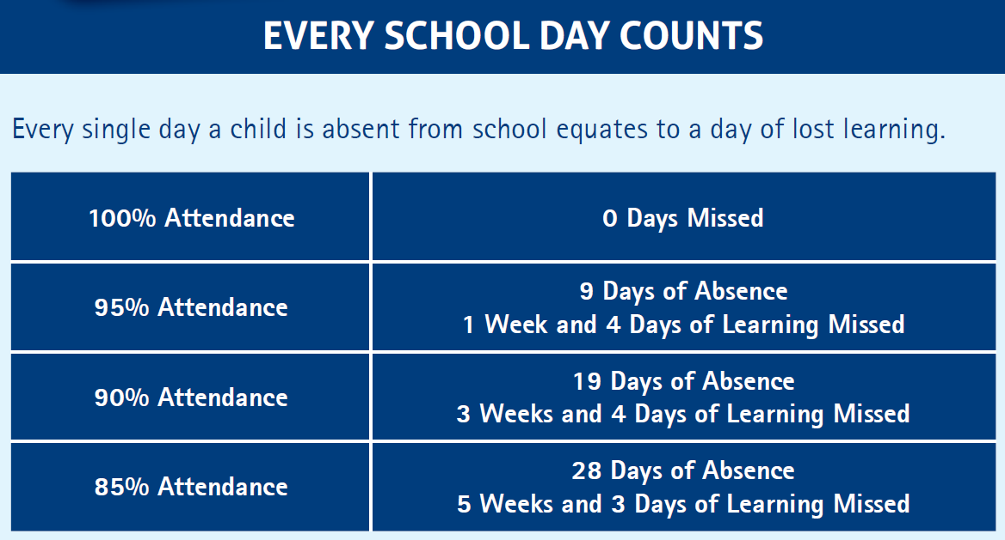

Slide 22
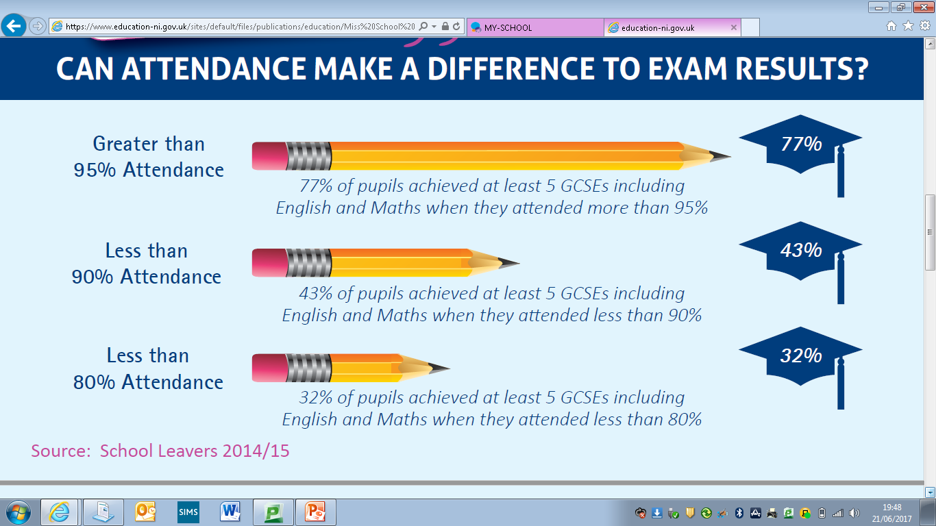

Slide 23
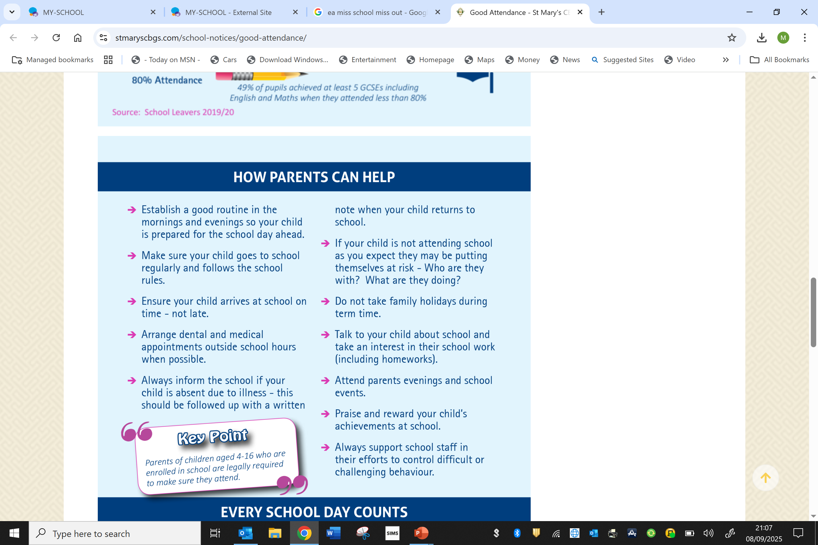
Supporting your Child’s Attendance
Send your child to school every day.
Ensure your child arrives punctually.
Ensure your child knows how important education is.
Make sure your child gets enough sleep.
Notes:
8-10 hours of sleep for a teenager

Slide 24
Key Dates, Assessment and Reporting
22nd October, Parent/carer afternoon 3.15 – 5.15pm
4th – 7th November, Year 11 and Year 12 Tracking 1 exams.
November 2026 – OFFICIAL GCSE Exams
12th – 23rd January 2026 – Year 12 mock exams
February/March, OFFICIAL GCSE Exams
May/June – OFFICIAL GCSE Exams

Slide 25
Public Exams in
Year 12
November | February/March | Summer
DA Science - Chemistry - Physics - Biology SA Science - Chemistry - Physics - Biology Maths - M1 – M8 modules English Language - Units 1 & 4 | DA Science SA Science Maths | Maths English English Literature DA Science - Physics unit 1 BACS Business Studies History Technology and Design Digital Technology Health and Social Care Geography
Timetables and expectations will be delivered to students prior to each exam season
Notes:
This is not a complete list but identifies a series of examinations throughout the year.
Pupils are asked to speak with their teachers regarding when they will be taking GCSE modules in their subject.
November exams 10th - 21st November 2025

Slide 26

Notes:
3 tracking assessments throughout year including official mocks in March

Slide 27
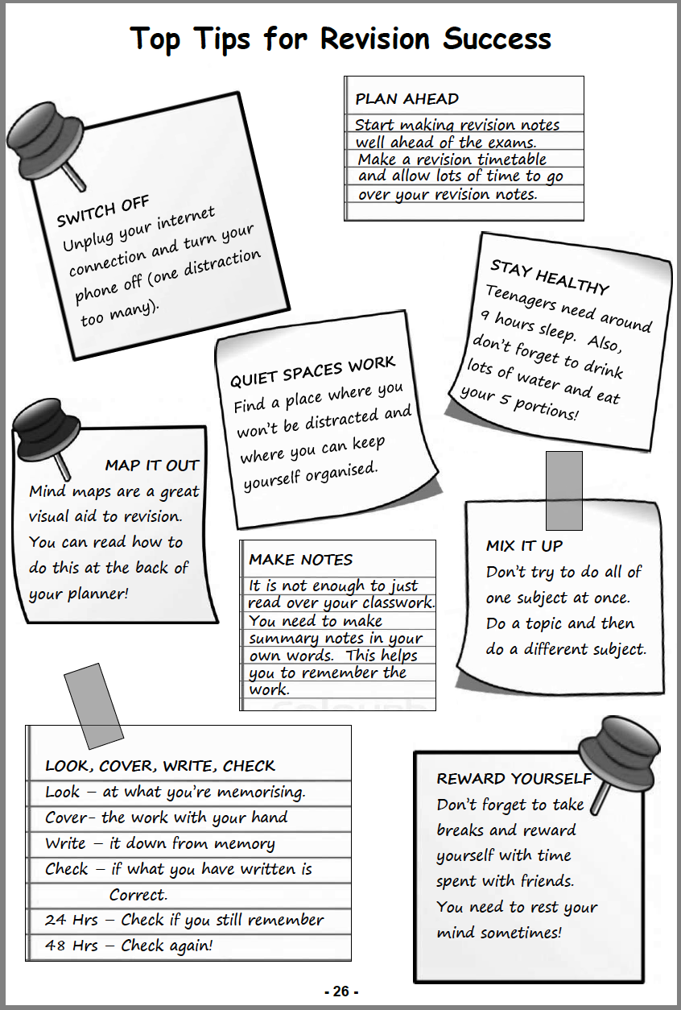
Homework and Revision

Slide 28

Supporting a Year 12 Student at Home
  Being aware of key dates – tracking dates, special events etc.
  Support with homework/revision/ checking homework diaries
  Encouraging good attendance and time keeping
  Encouraging organisation and being ready to learn
  Encouraging extra-curricular and the social aspect of school life
  Create a workspace where pupils can be monitored

Slide 29
Pastoral Support and Points of Contact
Form Teacher or Subject Teacher – First Point of Contact.
If you wish to meet with a member of staff, please ensure an appointment is made.
If you wish to arrange a phone call with a member of staff, please contact the school office.
Please note the school office hours:
Monday – Thursday: 8:30 a.m. – 4:15 p.m.
Friday 8:30 – 3:30 p.m.

Slide 30

Counselling
Two Counsellors will be available 3 days per week
Speak to form teacher to enquire

Slide 31

Students Taking Responsibility for their own Progress
Knowing target grades and teacher predictions to identify gaps
Identifying strengths and areas to be improved
Working toward closing gaps

Slide 32


